Slide 1

Empowering Indian Farmers through Expert Connections

Slide 2
Problem Statement:
India faces a growing crisis of farmer suicides due to a combination of economic hardship, environmental degradation, and inadequate support systems. These challenges leave farmers feeling isolated and hopeless, pushing them to desperate measures.
To address this crisis, we need to connect them with industry experts who can offer practical solutions and restore a sense of hope for a better future.
Farmer suicides in India, their debt burdens, and the impact of environmental degradation on their livelihoods.

Slide 3
Proposed Solution
Develop a AgroCare allowing farmers to connect with agricultural experts, financial advisors, and mental health professionals.
Provide farmers with access to resources and guidance tailored to their specific challenges linked debt management, drought-resistant crops, etc.
Showcase success stories of farmers who have overcome similar challenges with expert support. This will inspire hope and demonstrate the viability of solutions.

Slide 4




AgroCare Interface
USER
PERSONALIZED
REGISTRATION
SECURE LOGIN
Upon successful registration, users can securely log in to their Agro Care accounts, gaining access to a wide array of features and resources. The login process is designed with robust security measures to ensure the confidentiality and integrity of user data, providing peace of mind for all participants.
DASHBOARD
Agro Care offers a user- friendly registration process that allows farmers, agricultural experts, and interested individuals to create personalized accounts. By providing essential information such as location, crop preferences, and farming experience, the website can tailor its services and recommendations to meet the unique needs of each user.
After logging in, users are directed to their personalized Agro Care dashboard, where they can manage their profile, access relevant information, and engage with the broader agricultural community. This dashboard serves as a centralized hub for all user activities and interactions within the Agro Care ecosystem.

Slide 5




Agro Care Dashboard
COMMUNITY ENGAGEMENT
The dashboard also facilitates seamless community engagement, allowing users to connect with fellow farmers, share experiences, ask questions, and collaborate on innovative solutions. This collaborative environment fosters the exchange of knowledge and the collective advancement of sustainable agriculture.
Crop Management
The Agro Care dashboard provides comprehensive tools for crop management, enabling users to track the progress of their farming operations, monitor crop health, and receive personalized recommendations based on their specific growing conditions and cultivation practices.
RESOURCE LIBRARY
Agro Care's extensive resource
library offers a wealth of
information, including educational
articles, video tutorials, and expert-
curated guides on various
agricultural topics. Users can easily access this knowledge base to enhance their understanding and stay up-to-date with the latest industry trends and best practices.
Analytical Tools
Agro Care's dashboard integrates advanced analytical tools that provide users with valuable insights into their farming operations. From yield forecasting to cost-benefit analysis, these tools empower farmers to make data-driven decisions and optimize their productivity and profitability.

Slide 6
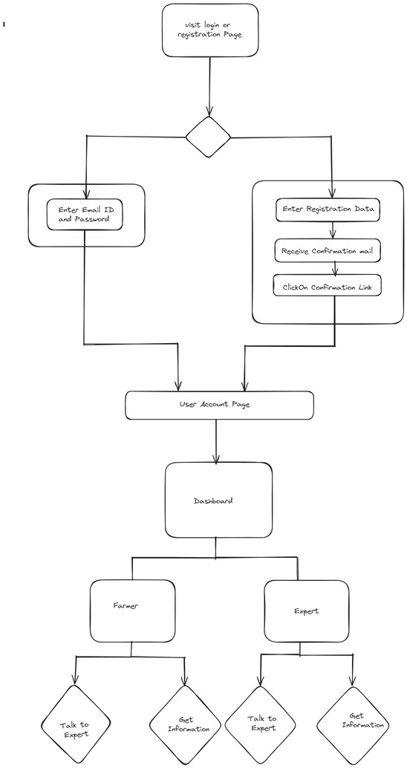
Block diagram:

Slide 7
ADDRESSING FARMING CONSTRAINTS
Water
Management
Agro Care offers comprehensive water management solutions, providing guidance on efficient irrigation techniques, water conservation strategies, and the use of drought-resistant crops. This helps farmers optimize their water usage and adapt to water scarcity issues.
Pest and Disease Control
The platform's expert- curated resources equip farmers with effective, environmentally-friendly pest and disease management strategies. This includes the recommendation of
Soil Health
Improvement
Agro Care emphasizes the importance of soil health, offering guidance on
Market Access and Financing
To address the challenges of market access and financial constraints, Agro
sustainable soil management Care connects farmers with practices, such as crop relevant resources,
rotation, cover cropping, and including information on
the application of organic amendments. These
local and regional markets, access to microfinance initiatives, and government agricultural support programs. This empowers farmers to overcome these barriers and achieve greater economic stability.
integrated pest management strategies help farmers
(IPM) techniques, the use of natural deterrents, and the adoption of organic cultivation practices.
enhance soil fertility, reduce erosion, and maintain long- term agricultural productivity.

Slide 8
Thank You

